Slide 1

Unit -8 Penetration Testing
CSE3501 Information Security Analysis and Audit
Dr.S.Geetha
Professor
School of Computer Science & Engineering
VIT University, Chennai Campus
geetha.s@vit.ac.in

Slide 2
Outline
What is Penetration Testing?
What is tested in PenTest?
PenTest Stages
Pre Attack Phase
Attack Phase
Post Attack Phase
Reconnaissance
Active
Passive
Categories of Vulnerabilities
Case Study

Slide 3
What is Penetration Testing
What Is Penetration Testing?
We can figure out the vulnerabilities of a computer system, a web application or a network through penetration testing.
A penetration test tells whether the existing defensive measures employed on the system are strong enough to prevent any security breaches. Penetration test reports also suggest the countermeasures that can be taken to reduce the risk of the system being hacked.

Slide 4
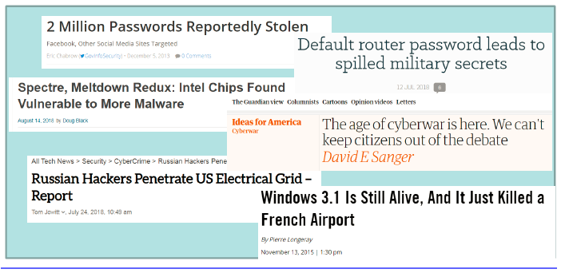
What is PenTest necessary at all?
Computer systems have several security problems

Slide 5
What is the reason for having so many
security issues?
Lack of money
Lack of time
Lack of expertise
Negligence
Convenience
Old systems
Too complex systems
3rd party components
And many others…

Slide 6
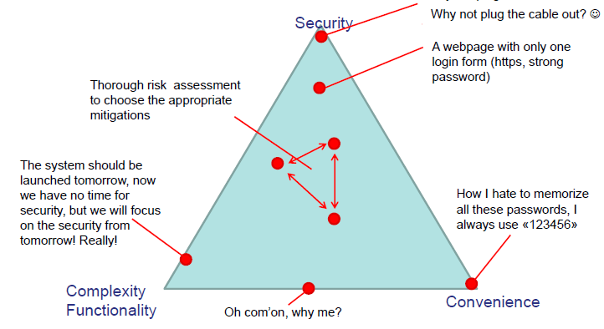
How does the usability and functionality
influence the security?

Slide 7
Causes of Vulnerabilities
Design and development errors: There can be flaws in the design of hardware and software. These bugs can put your business-critical data at risk of exposure.
Poor system configuration: This is another cause of vulnerability. If the system is poorly configured, then it can introduce loopholes through which attackers can enter into the system & steal the information.
Human errors: Human factors like improper disposal of documents, leaving the documents unattended, coding errors, insider threats, sharing passwords over phishing sites, etc. can lead to security breaches.
Connectivity: If the system is connected to an unsecured network (open connections) then it comes in the reach of hackers.
Complexity: The security vulnerability rises in proportion to the complexity of a system. The more features a system has, the more chances of the system being attacked.

Slide 8
Causes of Vulnerabilities
Passwords: Passwords are used to prevent unauthorized access. They should be strong enough that no one can guess your password. Passwords should not be shared with anyone at any cost and passwords should be changed periodically. In spite of these instructions, at times people reveal their passwords to others, write them down somewhere and keep easy passwords that can be guessed.
User Input: You must have heard of SQL injection, buffer overflows, etc. The data received electronically through these methods can be used to attack the receiving system.
Management: Security is hard & expensive to manage. Sometimes organizations lack behind in proper risk management and hence vulnerability gets induced in the system.
Lack of training to staff: This leads to human errors and other vulnerabilities.
Communication: Channels like mobile networks, internet, telephone opens up security theft scope.

Slide 9
Why ethical hacking is necessary at all?
Checking the system f rom the attacker’s perspective can reveal serious security deficiencies
The «attacker» thinks like a real hacker (but not totally)
Do we use the same methodology as the real hackers?
Do we have the same goals?
Do we have to hide ourselves when ethically hacking?
What makes hacking ethical?
What is allowed and what is not?
The system security cannot be guaranteed without deep and regular penetration testing
Can it be guaranteed with penetration testing? Unfortunately not always perfectly, the keyword is the appropriate mitigation

Slide 10
Why ethical hacking is necessary at all?
Financial or critical data must be secured while transferring it between different systems or over the network.
Many clients are asking for pen testing as part of the software release cycle.
To secure user data.
To find security vulnerabilities in an application.
To discover loopholes in the system.
To assess the business impact of successful attacks.
To meet the information security compliance in the organization.
To implement an effective security strategy in the organization.

Slide 11
Vulnerability Classification
1. Misconfigurations
2. Default installations
3. Buffer overflows
4. Unpatched servers
5. Default passwords
6. Open services
7. Application flaws
8. Open system flaws
9. Design flaws

Slide 12
The motivation behind hacking – Why?
To understand the real hackers, first we have to understand the motivations:
• What a cool thing to be a hacker
• Because I can
• Money
• Revenge
• Annoyance
• Protesting against something
• Organized and well-paid professional groups (mafia and governmental groups)

Slide 13
The goal of hacking
Break the information security triple (confidentiality, integrity, availability)
Steal confidential information
Modify data
Make services unavailable (Denial Of Service)
To promote security? YES!

Slide 14
Type of hackers
• Black hat hackers: with malicious intent
• White hat hackers: perform penetration testing to promote the security
• Script kiddies: amateurs (usually young kids) using publicly available software tools to attack
• Protest hackers (protest against something e.g. anonymous)
• Grey hat hackers: usually white hat, but can be black hat
• Red hat hackers: Stopping black hat hackers by attacking them
• Blue hat hackers: Hacking in order to take revenge
• Green hat hackers: beginners to hacking

Slide 15
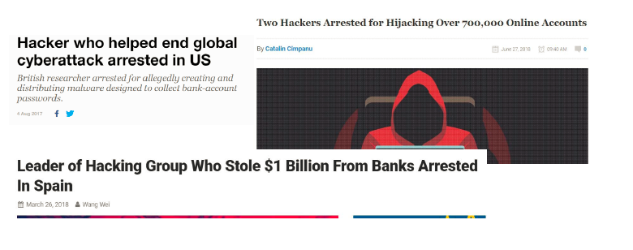
Be ethical and legal, it’s never worth
doing anything against the law!!!

Slide 16
Differences between ethical and nonethical
hacking
• Task: Find the admin password of «NonExistingBank AS»
• How do I start? Which one of these will be used by the black hat and the white hat hackers?
– Try with the websites, maybe there’s a server side scripting flow?
– Try to apply for an account to have access to password protected
sites?
– Try with low level exploitation against the server?
– Try to access the DMZ through a less controlled service?
– Try to sneak inside the building to have access to the internal network?
– Try social engineering emails against the employees?
– Try to make friendship with the system admin?

Slide 17
Differences between ethical and non-ethical
hacking
Illegal
Steal information, modify data, make service unavailable for own purpose
Find the easiest way to reach the goal (weakest link)
Do not care if the system will be destroyed (but not too early)
Without documentation
Without report, delete all clues
• Legal (contract)
• Promote the security by
showing the vulnerabilities
• Find all vulnerabilities
• Without causing harm
• Document all activities
• Final presentation and report

Slide 18

What is to be tested?
Software (Operating system, services, application)
Hardware
Network
Processes
End-user behavior

Slide 19


Main steps of hacking
Information gathering
Identifying the target domain
Finding vulnerabilities
Exploiting the vulnerabilities
Lateral movements
Carry out the goal

Slide 20
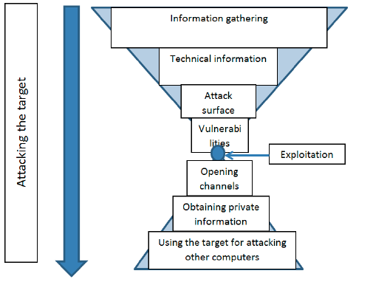
Steps of an attack with available info as
the PenTest process proceeds

Slide 21
Detailed steps of PenTest
1. General information gathering: collecting all available information from the target and systemize the information
2. Technical information gathering: collecting network and system specific information like target ip ranges
3. Identifying available hosts in the target network (which computer can be attacked)
4. Identifying available services in the target network (which service can be attacked)
5. Manual mapping of the services (to check how it looks like, the impressions, system reactions, mitigations, etc.)

Slide 22
Detailed steps of PenTest
6. Automatic vulnerability scanning (intelligent tools with huge vulnerability database)
7. Manual verification of the findings (to check if the previous findings are real – true positive)
8. Exploitation
9. Lateral movements (to move through the network)
10. Ensure access until the end of the project
11. Achieve primary and secondary goals
12. Remove clues
13. Reporting and presentation
14. Removing the attacking files!!! (tools, data, script created temporarily during the pentest)

Slide 23
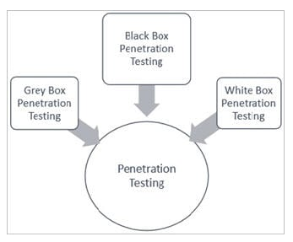
Type of ethical hacking projects
From the attacker’s location point of view:
• External penetration testing
• Web hacking
• Internal penetration testing
• Wireless penetration testing
• Social Engineering
From the attacker’s access (right) point of view:
• Black box testing
• Grey box testing
• White box testing

Slide 24
PenTest Types
Social Engineering Test
to make a person reveal sensitive information like password, business-critical data, etc.
mostly done through phone or internet and it targets certain helpdesks, employees & processes.
Human errors are the main causes of security vulnerability.
Security standards and policies should be followed by all staff members to avoid social engineering penetration attempts.
An example of these standards includes not to mention any sensitive information in the email or phone communication. Security audits can be conducted to identify and correct process flaws.
Web Application Test
Using software methods one can verify if the application is exposed to security vulnerabilities. It checks the security vulnerability of web apps and software programs positioned in the target environment.

Slide 25
PenTest Types
#3) Physical Penetration Test: Strong physical security methods are applied to protect sensitive data. This is generally used in military and government facilities. All physical network devices and access points are tested for the possibilities of any security breach. This test is not much relevant to the scope of software testing.
#4) Network Services Test: This is one of the most commonly performed penetration tests where the openings in the network are identified by which entry is being made in the systems on the network to check what kind of vulnerabilities are there. It can be done locally or remotely.
#5) Client-side Test: It aims to search and exploit vulnerabilities in client-side software programs.
#6) Remote dial-up war dial: It searches for modems in the environment and tries to log in to the systems connected through these modems by password guessing or brute-forcing.
#7) Wireless Security Test: It discovers the open, unauthorized and less secured hotspots or Wi-Fi networks and connects through them.

Slide 26
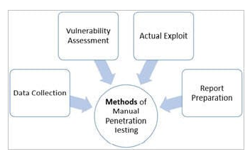
PenTest Techniques
Manual Penetration Test
Using automated penetration test tools
Combination of both manual and automated processa
Manual Penetration Test
It's difficult to find all vulnerabilities using automated tools. There are some vulnerabilities that can be identified by manual scan only. Penetration testers can perform better attacks on applications based on their skills and knowledge of the system being penetrated.
The methods like social engineering can be done by humans only. Manual checking includes design, business logic as well as code verification.

Slide 27
General information gathering
Usually the first step of every attack
Before getting contact with the target we need to prepare for the attack
General information gathering covers all the efforts that is done for collecting all the information from the target
The collected information should be analyzed as well in order to filter the important information
Sometimes it is not obvious which information will be useful later, all information should be systemized
The result of the information gathering is a huge dataset with dedicated information (e.g. user lists, etc.)

Slide 28
Methods to do information gathering
Google and all search engines are best friends
Simple search engine queries
Specific search engine queries (google hacking, see later)
Cached data (data that are not online right now, but can be restored)
The social media is another best friend
Companies and persons spread lots of information from themselves
We can create personal and company profiles
We can identify key persons and other key information

Slide 29
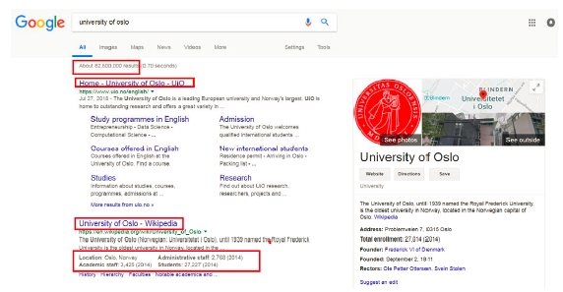
Simple information gathering using
Google
Default website (domain name), other sites
History, several public data (faculties, number of staff members)

Slide 30
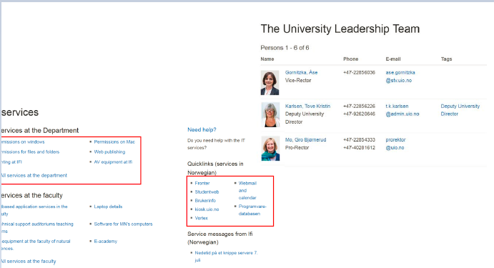
Simple information gathering using
Google
Keypersons with contact details
Important pages
Services

Slide 31
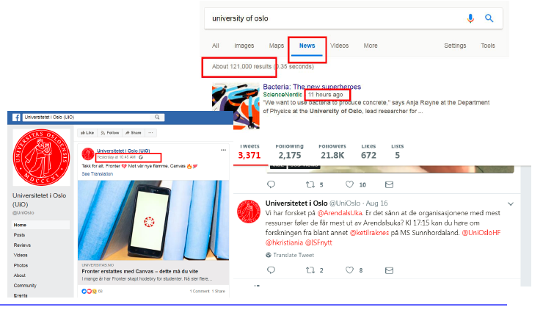
Collecting actual target related
information
Reading the news
Social Media Information

Slide 32
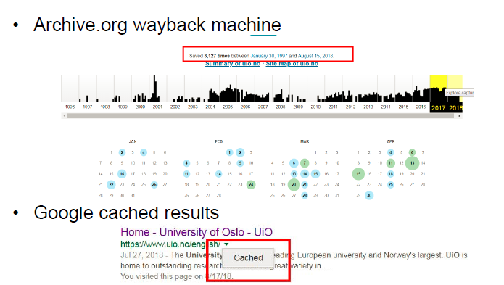
Collecting cached information

Slide 33
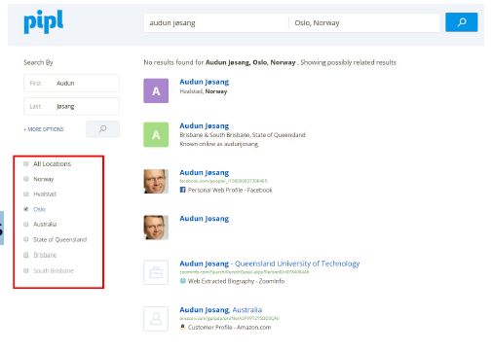
Pipl.com – Finding accounts
Personal information
Net catalogues
Academic records
Social accounts

Slide 34
Using social media to build personal
profile
Work and education
Places of living
Contact info
Family relationships
Details
Life events
Photos
Favorites (music, sports, films, etc..)
Friends
Timeline data

Slide 35
Using social media to carry out social
engineering attacks - examples
Social Engineering using private information:
Isak spent 5 days at the Scandic Hotel Kristiansand. He posted on Facebook (Checked in Scandic Kristiansand). 5 days later Isak receives an email from the ‘’Hotel’’ (attacker). Dear guests! Our hotel would like to surprise all our guests between the age of 14 and 24 who visited us during the last month with a SuperMario Cart game as a summer holiday surprise. Please fill in the following form and provide your address: link We hope you enjoyed your stay at our hotel, etc..
Building personal profile using social media
Stine has a Facebook account where she listed all her favorites. One of her favorite singer is Rihanna. The attacker brute-forces Stina’s password and finds out that one of her passwords is Diamonds2012. The attacker logs in to Stine’s Facebook account and steals private photos, writes weird messages to her friends, etc.
Everyone can be misled, it’s just a question of timing and story!
Every information can be important, hackers collect all available information and systemize them before planning the attack!

Slide 36
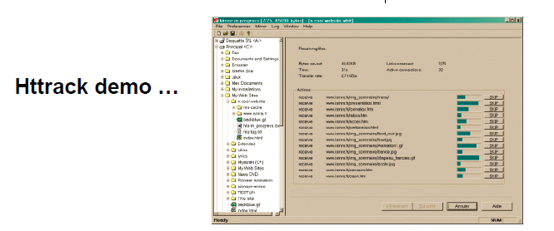
Collecting information from webpages
All static information can be downloaded at once (noisy, but useful)
Several tools exist like wget or Httrack

Slide 37
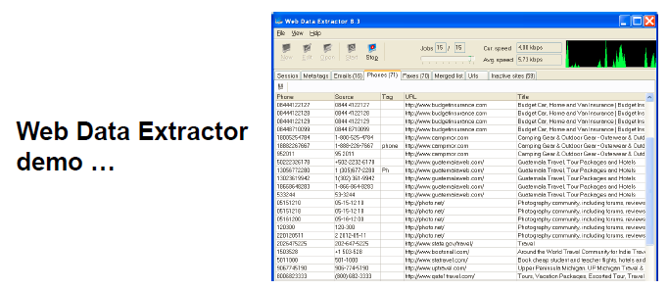
Specific information search
We can look for specific info such as email addresses, phone numbers, meta data, etc.

Slide 38
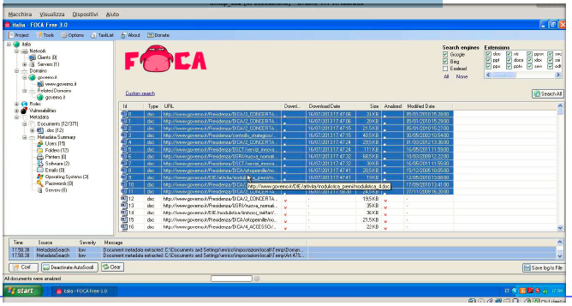
Specific information search
Foca is able to find documents by extensions
It also shows several technical information

Slide 39
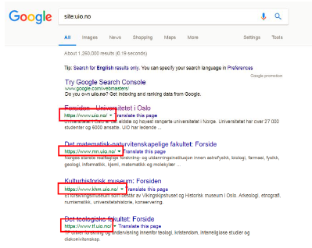
Information gathering with Google
hacking
Using specific Google
queries we can use smart filtering
or get «hidden» data
Filter to domain: use the
site keyword
Negative filtering is also
possible:
site:uio.no -www

Slide 40
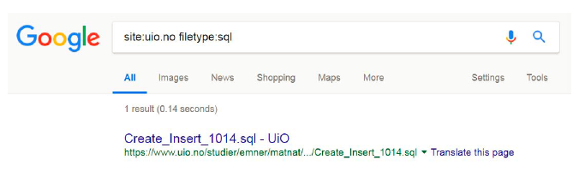
Information gathering with Google
hacking
Filter to file type with extension: use the type keyword
Interesting file extensions: doc, xls, txt, conf, inc, sql, …
Expressions can be combined

Slide 41
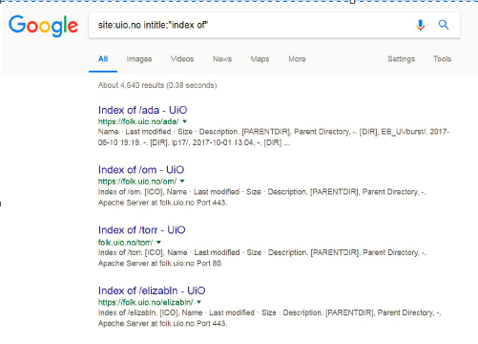
Information gathering with Google
hacking
The intitle expression
filters according to the
site title, the inurl filters
for the url content
Try this one: site:uio.no
intitle:″index of″
(directory listing)

Slide 42
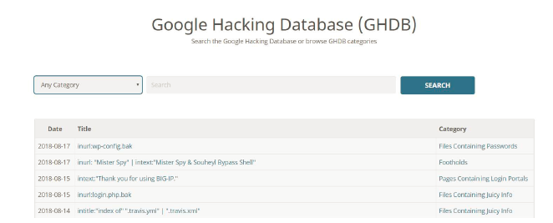
Information gathering with Google
hacking
There is a database (goog le hack database – ghdb) that contains up-to-date google hack expressions (check the exploit-db website)

Slide 43
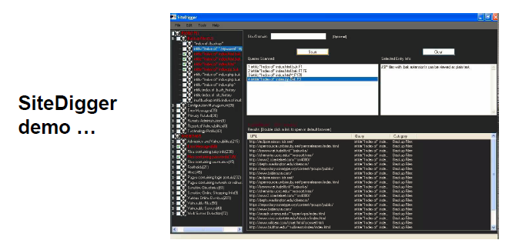
Tools supporting automatic Google
hacking
SiteDigger (by FoundStone) is an old tool that carries out google hacking using its own database

Slide 44

Kali Linux (http://kali.org)
Debian based Linux distribution with
hundreds of preinstalled hacking tools
Easy to use, tools are classified
according to the hacking tasks and
steps (info gathering, forensics,
vulnerability assessment, etc.)
Easy to install (ready and up-to-date
Vmware and Virtualbox images)
https://www.softwaretestinghelp.com/penetration-testing-guide/

Slide 45
Penetration Testing Tools And Companies
Automated tools can be used to identify some standard vulnerabilities present in an application. Pentest tools scan code to check if there is a malicious code present which can lead to the potential security breach. Pentest tools can verify security loopholes present in the system by examining data encryption techniques and figuring out hard-coded values like username and password.
Criteria to select the best penetration tool:
It should be easy to deploy, configure and use.
It should scan your system easily.
It should categorize vulnerabilities based on severity that needs an immediate fix.
It should be able to automate the verification of vulnerabilities.
It should re-verify exploits found previously.
It should generate detailed vulnerability reports and logs.
Once you know what tests you need to perform you can either train your internal test resources or hire expert consultants to do the penetration task for you.

Slide 46
Penetration Testing Tools And Companies
Acunetix
ScienceSoft
ImmuniWeb
Open Source Tools
Nmap
Nessus
Metasploit
Wireshark
OpenSSL
Commercial
Pure hacking
Torrid Networks
Secpoint
Veracode

Slide 47
Case Study
Check if the web application is able to identify spam attacks on contact forms used on the website.
Proxy server Check if network traffic is monitored by proxy appliances. The proxy server makes it difficult for hackers to get internal details of the network thus protecting the system from external attacks.
Spam email filters – Verify if incoming and outgoing email traffic is filtered and unsolicited emails are blocked.
Many email clients come with inbuilt spam filters that need to be configured as per your needs. These configuration rules can be applied to email headers, subject or body.
Firewall – Make sure the entire network or computers are protected with firewalls. A Firewall can be software or hardware to block unauthorized access to a system. A Firewall can prevent sending data outside the network without your permission.
Try to exploit all servers, desktop systems, printers, and network devices.
Verify that all usernames and passwords are encrypted and transferred over secure connections like https.
Verify information stored in website cookies. It should not be in a readable format.
Verify previously found vulnerabilities to check if the fix is working.
Verify if there is no open port in the network.

Slide 48
Case Study
Verify all telephone devices.
Verify WIFI network security.
Verify all HTTP methods. PUT and Delete methods should not be enabled on a web server.
Verify if the password meets the required standards. The password should be at least 8 characters long containing at least one number and one special character.
Username should not be like “admin” or “administrator”.
The application login page should be locked upon a few unsuccessful login attempts.
Error messages should be generic and should not mention specific error details like “Invalid username” or “Invalid password”.
Verify if special characters, HTML tags, and scripts are handled properly as an input value.
Internal system details should not be revealed in any of the error or alert messages.
Custom error messages should be displayed to end-users in case of a web page crash.
Verify the use of registry entries. Sensitive information should not be kept in the registry.
All files must be scanned before uploading them to the server.

Slide 49
Case Study
Sensitive data should not be passed in URLs while communicating with different internal modules of the web application.
There should not be any hardcoded username or password in the system.
Verify all input fields with long input string with and without spaces.
Verify if reset password functionality is secure.Verify application for SQL Injection.
Verify application for Cross-Site Scripting.Important input validations should be done at the server-side instead of JavaScript checks at the client-side.
Critical resources in the system should be available to authorized persons and services only.
All access logs should be maintained with proper access permissions.
Verify user session ends upon log off.
Verify that directory browsing is disabled on the server.
Verify that all applications and database versions are up to date.
Verify URL manipulation to check if a web application is not showing any unwanted information.
Verify memory leak and buffer overflow.
Verify if incoming network traffic is scanned to find Trojan attacks.

Slide 50
Case Study
Verify memory leak and buffer overflow.
Verify if incoming network traffic is scanned to find Trojan attacks.
Verify if the system is safe from Brute Force Attacks – a trial and error method to find sensitive information like passwords.
Verify if the system or network is secured from DoS (denial-of-service) attacks. Hacker can target network or a single computer with continuous requests due to which resources on the target system gets overloaded resulting in the denial of service for legit requests.
Verify application for HTML script injection attacks.
Verify against COM & ActiveX attacks.
Verify against spoofing attacks. Spoofing can be of multiple types – IP address spoofing, Email ID spoofing,ARP spoofing, Referrer spoofing, Caller ID spoofing, Poisoning of file-sharing networks, GPS spoofing.
Check for an uncontrolled format string attack – a security attack that can cause the application to crash or execute the harmful script on it.
Verify XML injection attack – used to alter the intended logic of the application.
Verify against canonicalization attacks.
Verify against canonicalization attacks.

Slide 51
Case Study
Verify if the error pages are displaying any information that can be helpful for a hacker to enter into the system.
Verify if any critical data like the password is stored in secret files on the system.
Verify if the application is returning more data than it is required.
Pen Testing Standards
PCI DSS (Payment Card Industry Data Security Standard)
OWASP (Open Web Application Security Project)
ISO/IEC 27002, OSSTMM (The Open Source Security Testing Methodology Manual)
Certifications
GPEN
Associate Security Tester (AST)
Senior Security Tester (SST)
Certified Penetration Tester (CPT)
Finally, as a penetration tester, you should collect and log all vulnerabilities in the system. Don't ignore any scenario considering that it won't be executed by end-users.

